Slide 1
Water Challenges of MENA Countries
Growing Scarcity
Political conflicts past and present
Managing Supply and Demand through Pricing
Water depletion and over use
Climate Change

Slide 2
Growing Scarcity: Contributing factors
90% of region receives less than 250 mm per year on average in rainfall which is about what San Diego, Elko, Nevada, Flagstaff AZ, Reno Nevada receive on average
Rapid growth of population of region
Aridity, possibly growing over time in several areas of the region, periodic drought , global warming, accelerated evaporation especially likely to hit region
Relatively few rivers and other natural water supplies
Incentives to over-use aquifers, rivers and other sources in one’s region before they go on to others.
Pollution, quality decline, spread of water-borne diseases.
Rising living standards→ rising demand for water

Slide 3
Decreasing Supplies per capita
1960 Average MENA region: 2000 m³ per capita
2005 “ “ “ : 1200 m³
2050 “ “ “ : 650 m³
Also declining quality in much of the region, increasing salinity, pollution, increasing seawater intrusion into aquifers near coasts
These are all low relative to world average of close to 7000 m³ Shetty (2006) , 3% of those in LAC region

Slide 4
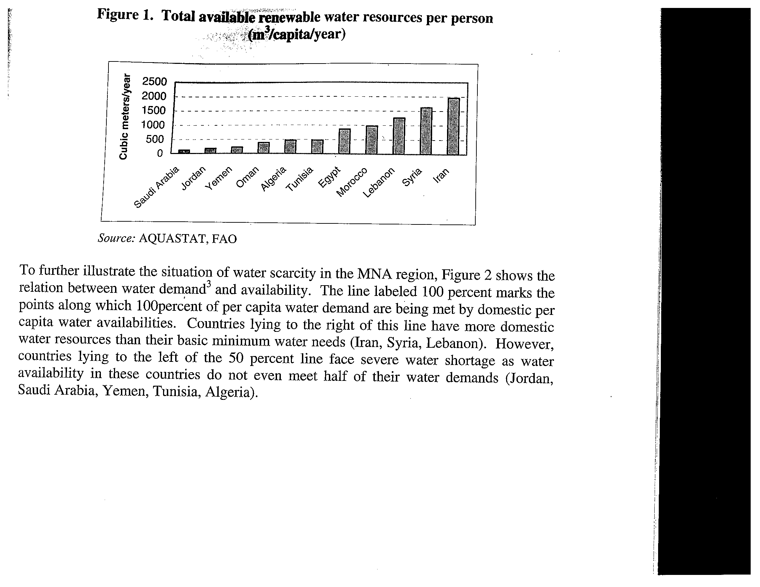

Slide 5
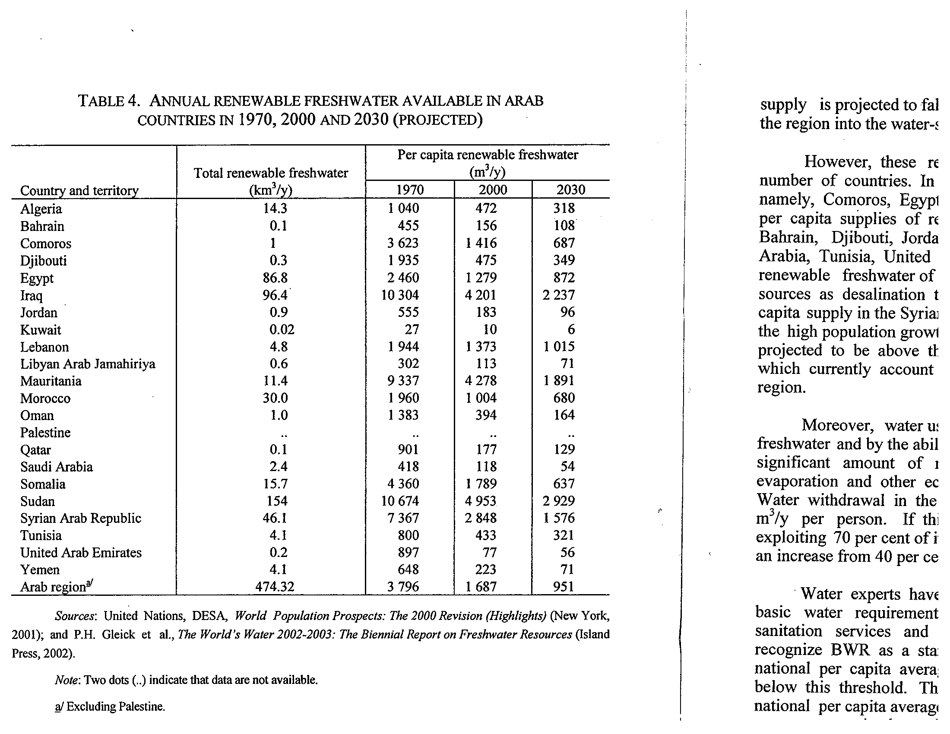

Slide 6
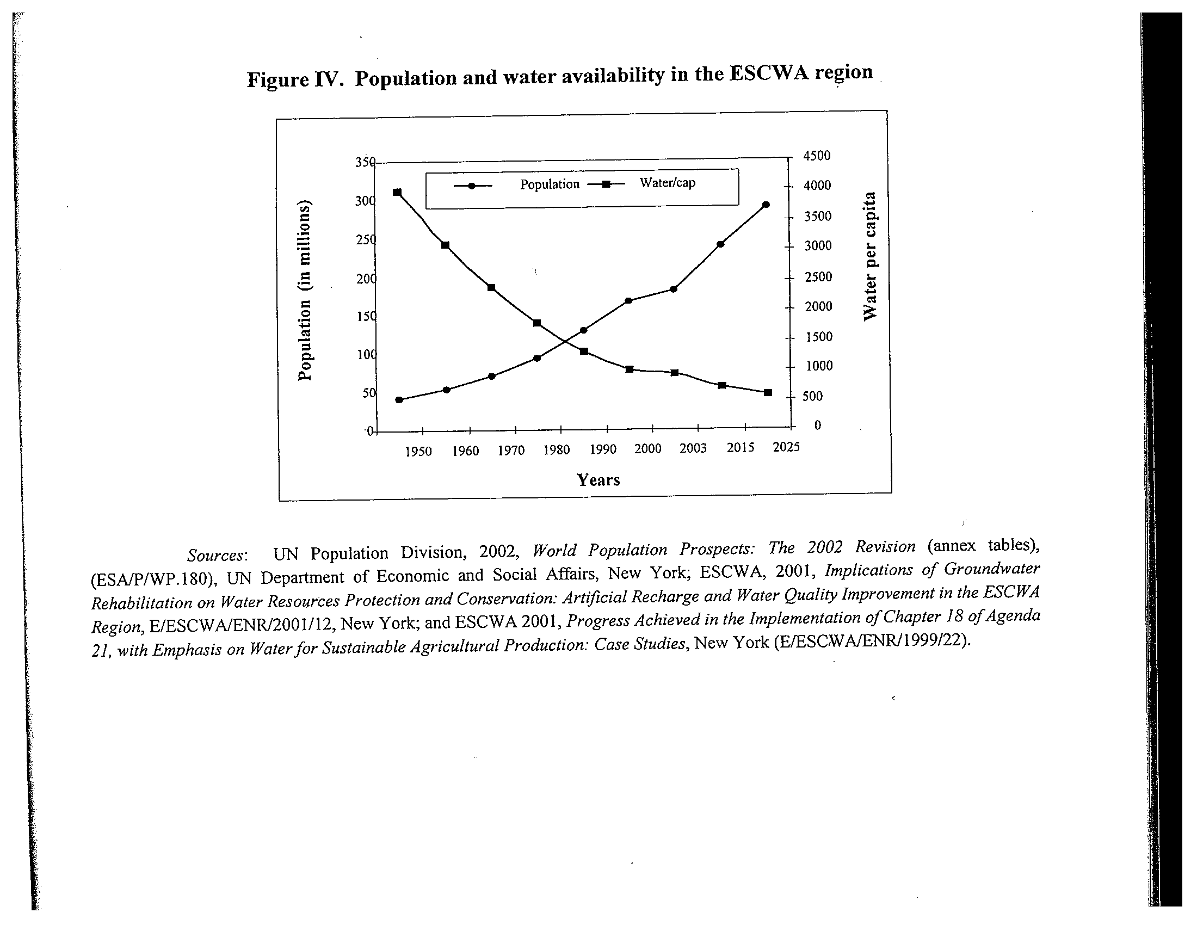

Slide 7
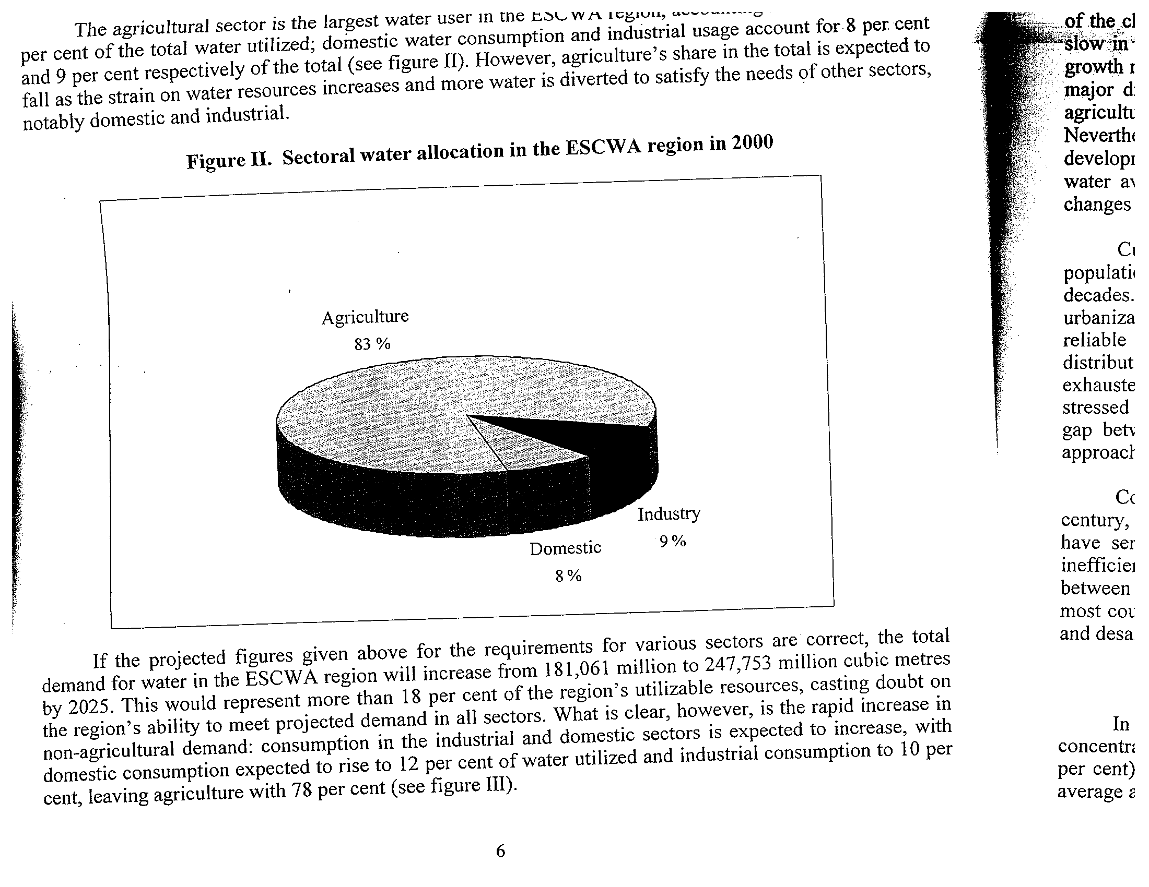

Slide 8
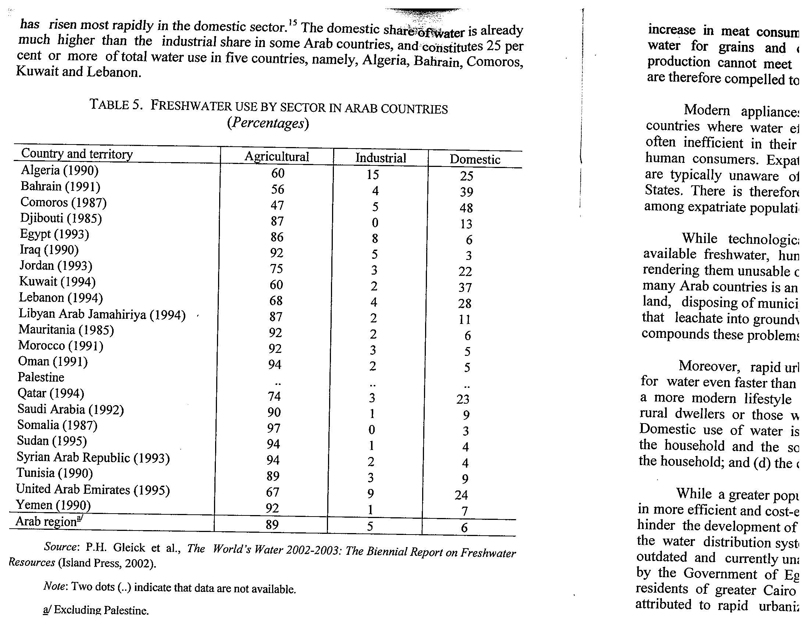

Slide 9
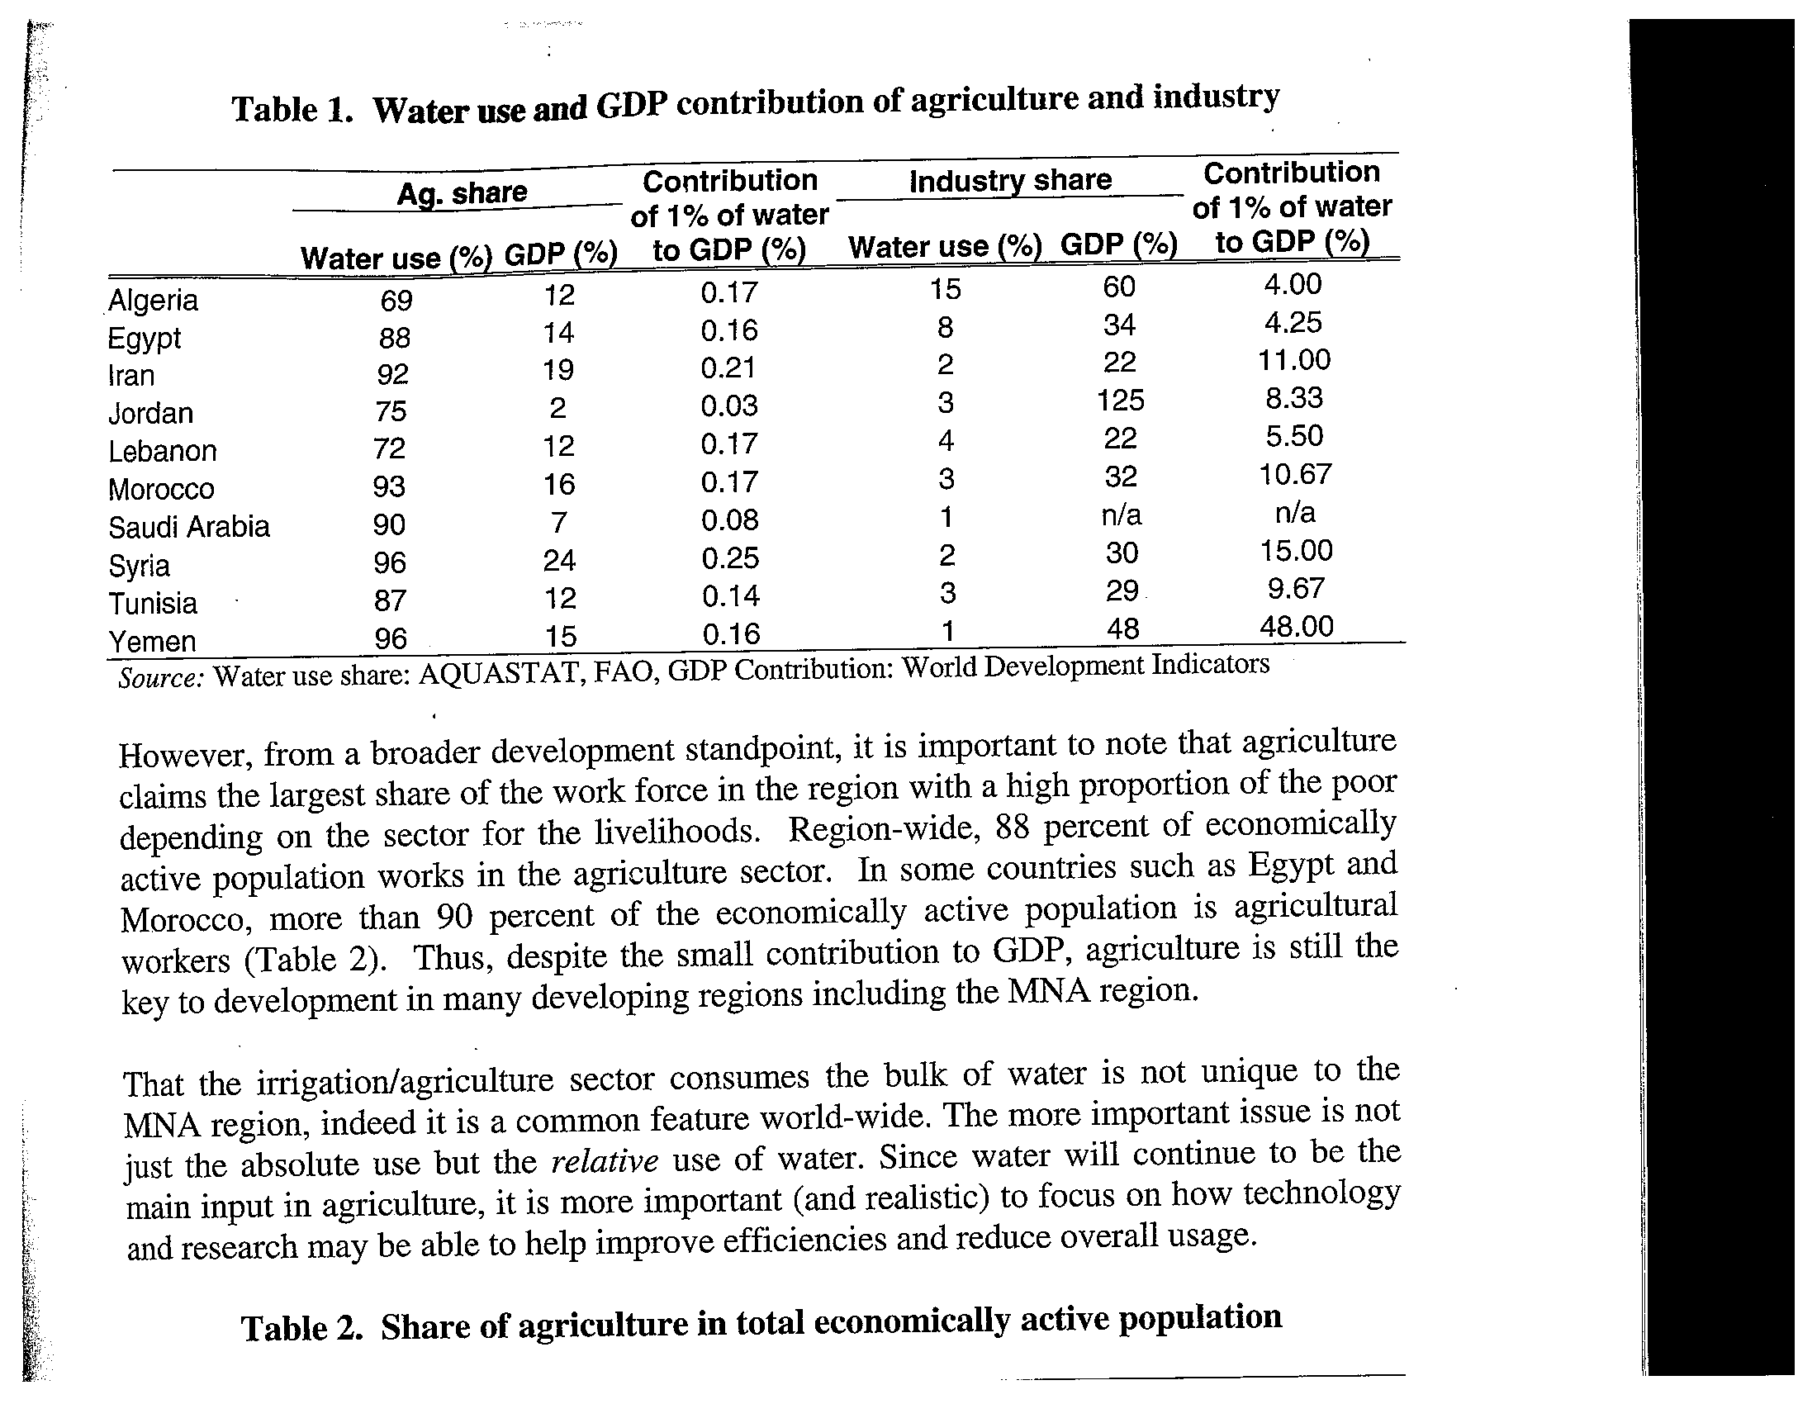

Slide 10
Relation between aridity and volatility
Periodic droughts, hoarding of water, degradation of plant life, which then leads to more rapid runoff, erosion, lower quality soils and plant life, more rapid evaporation
Even within short distances average and volatility of rainfall can vary substantially
N. end of Gaza 400mm/yr. but 50 kms to South 250mm/yr
Even in same area: topography can matter a lot
Whereas seasonality is common, annual variability is unusually high in MENA
Makes it harder to establish sensible regulations
Encourages expensive investment in above ground storage. The wonderful qanat unfortunately limited to small distances

Slide 11
Falling water table and rising extraction costs
“Typical farmer near Sana’a has deepened his well by 50 meters over last 12 years and extracted only 1/3 as much water” WB 2002 Shetty 2006, p 8)
Also gives rise to rising sea levels and inundation with saline water
Lack of access to sanitation in rural areas has contributed to falling water quality

Slide 12
Scarcity breeds
Depletion
Diversion of sources to different destinations and uses
Conflicts among different classes of users, users vs. suppliers, different countries
Discontent, security concerns as water shortage pushes up against food security
Lower quality

Slide 13
MENA Especially dependent on other regions for water
2/3 of renewable water sources
MENA countries have the lowest levels of renewable fresh water in the world and declining

Slide 14
International Effects
Euphrates River going through Turkey, Syria and Iraq. Characterized as “exotic” because 80% of water originates in Turkey, two tributaries in NW Syria contribute another 18%. These are near the Turkish border such that Kolars (1994) has indicated that mining of aquifers in Turkey would seriously deplete these tributaries.
Whereas average flow across Syrian border was 29,940million m³ prior to 1974, when a huge GAP project is completed in Turkey by 2040 this will fall to 9070 million m³. Syria has plans to expand its own withdrawals by 12,000 million m³ by 2040
The consequence for Iraq: Instead of 30,670 million m³ by 2040 it could be 6559 million m^{3 ,} along with much lower quality, fertilizers, pesticides
Iraq could divert water from the Tigris but that source is threatened by similar irrigation projects in Turkey and Iran.

Slide 15
Property Rights
Water resources in a river basin constitute common property but generally without well defined rules as in a well functioning common property regime. Common pool resources: E. Ostrom Governing the Commons
Many different practices (Riparian (right by owner or bordering land), Original Use, Fairness) exist in the world
Such rights are a grey area in International Law. In 1970, UN Gen. Assembly adopted a resolution creating an International Law Commission to draft statutes regulating non-navigational use of international watercourses
In 1997 it drafted 37 articles with lots of sensible admonitions of all the factors that must be considered But which is most important? Came into law by 2000. But its allocation of rights is unclear.

Slide 16
Different Principles in Property Rights
Riparian: Rights belong to where the water comes from. Downstream users have to compensate upstream users to allow them to use it. This encourages efficient use
Original User: First user (e.g., downstream) has rights, upstream users have to compensate original user for loss of use. Again efficiency encouraged.

Slide 17
Provisions of the Convention
Art.5: Watercourse state shall in their respective territories utilize an international watercourse in an equitable and reasonable manner. In particular, it shall be used and developed with a view to attaining optimal and sustainable utilization thereof and benefits therefrom, taking into account the interests of the watercourse states concerned and adequate protection of the watercourse

Slide 18
Article 6: The relevant factors include
Geographic, hydrographic, climate, ecological
Social and economic needs of watercourse states
Population dependent on it in each w. state
Effects of use in one state on other w. states
Existing and potential uses of watercourse
Conservation, protection of water resources
Availability of alternatives to planned use
Weights assigned determined by their relative importance

Slide 19
Coase Theorem and Its Application to Euphrates
“With well-defined property rights we might expect negotiations to result in a conjunctive use of the resource that would be efficient”
Fisher 1995 invoked this to argue that efficiency can be separated from ownership
Original use could be compensated to give up some of its rights and same with riparian.
But even with well-defined rights, such bargaining is rare

Slide 20
Conflicts over water in region
In Bible:
  Abraham and Philistines over wells of Beersheba
  Isaac and Guar over Esek well, settled in this case by digging a new well
In Hadiths (Islamic). Islamic Law (Sharia) is derived from word for water
Often viewed as Zero-sum security issue which tends to give rise to conflicts
Due to importance of large river basins, potential conflicts become international
International law less able to deal with issues than specially designed treaties.

Slide 21
Especially great conflict potential when most powerful actor is in a riparian lower position M.R. Lowi (1993)
This was Israel’s situation relative to Syria in Jordan River basin before 6 day war of 1967.
What Happened? Water a factor in war, Israel annexed Golan Heights of Syria and West Bank of Jordan and hence has the military power and riparian advantage. What leverage can Arabs use to get Israel to cooperate more over water? Little: Hence less potential for conflict
Turkey, Syria and Iraq over Euphrates with Turkey in an increasingly favorable position after weakening of Iraq after the Gulf War
Egypt most powerful, but lower riparian on Nile vis a vis Sudan and Ethiopia (Lowi 1993)
Perception of what other parties are doing can exacerbate conflict or alternatively induce cooperation for common good. Degrading of water by other party enhances conflict potential. Water misuse and degradation motive for Palestinian intifada

Slide 22
Things to Consider
40% of Water used in Israel is obtained from territories “captured” in various wars
Lowi (1993) argued that Israel-Arab wars were largely motivated by search for water security
Al Roubaie and Vicas (1997) argue that some of the arms buildup by the states involved should be attributed to the cost of water security

Slide 23
Conditions conducive to peaceful resolution of conflicts
Solutions be commensurate with complexity and scope of the problems, holistically
When waterway is international, best to manage its distribution and use equitably by cooperation through a flexible but stable institutional arrangement that requires prior notification of changes in usage.
Free flow and exchange of data and information
Treaties be backed up by legal sanctions to uphold them

Slide 24
Some Examples of Regional Coop.
Iran and Syria have established an agreement to manage the Euphrates River, but Turkey has not joined
Jordan, Syria signed an agreement concerning management of Yarmouk River in 1987, finally joined by Israel in 1994 but still does not include the Palestinian territories
Water still one of most contentious issues between Israel and Palestinians in reaching accord on Palestinian state

Slide 25
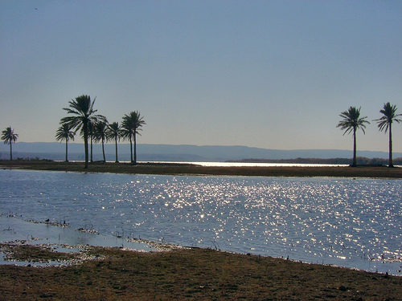
Euphrates in Syria

Slide 26
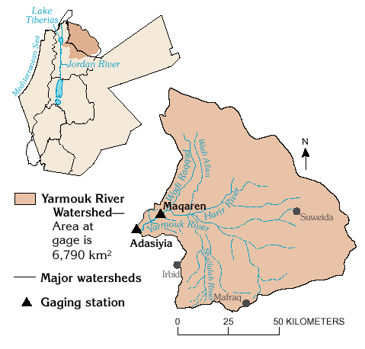
Yarmouk River: Syria, Israel, Jordan

Slide 27
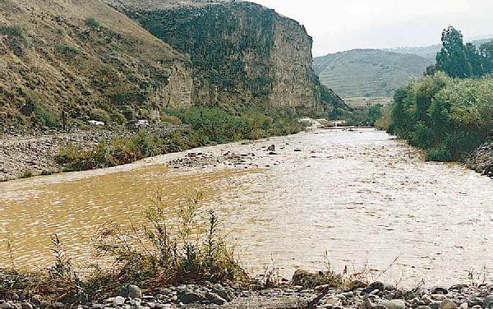
Yarmouk near site of alleged Israeli Pollution and near entry into Jordan

Slide 28
Policy Solutions
National
International
Local

Slide 29
Costs of Some Alternative Options
SOURCE | COST (US$/m³
Reducing demand by end user (recirculation, repair of leaks, improved technology) | 0.1-1.0
Wastewater treatment for Irrigation | 0.6-1.2
Desalination of brackish water | 0.9-1.4
Development of Marginal Resources | 1.1 1.7
Desalination of Seawater | 2.0-3.0

Slide 30
Considerations among these
Will depend on who the user will be (HH use demands the highest quality)
Other side effects of the technique
  Desalination very reliable except a likely target in warfare (Kuwait’s was hit in the Iraqi invasion of Kuwait)
  Desalination has environmental side effects , requires lots of energy, leaves highly saline brine that can be damaging to coastline
  SA already the world’s largest user of desalination, USA 2nd, UAE, Kuwait 3rd and 4th, Libya, Qatar 8th, 9th, Iran, Bahrain 11^{th,} 12th

Slide 31
Imports and Transportation of Water
Private bottling of water, much imported
Urban-rural gaps in use of bottled water
  Urban use higher than rural use in Yemen
  Rural use higher than urban in Jordan, Libya, Syria
  High 40% in both in Oman
Large projects to import water via pipeline
  Iran-Kuwait transporting water from the Karun River (UNESCWA 2003)

Slide 32
Alternative Allocation Systems
For each alternative need to consider transaction costs and enforceability , flexibility, efficiency, environmental effects
Pricing via Water Markets
  Groundwater use often not priced sufficiently, externalities
  Need water meters with no chance of cheating
  Knowledge of price elasticity of demand may be important
Public Allocation
  Large scale developments often too big for private sector, externalities may be important
  Often monopolies that require regulation
User based Allocation
  E.g. Farmer based irrigation schemes: collective action issues affect distribution of benefits

Slide 33
Water Market
May be more practical alternative though it too requires property rights to establish who should be compensated, by how much and by whom .
Various actors should consider carefully costs/benefits of alternative uses of water, like doing away with cultivation of rice in Southern Iraq which uses lots of water in favor of high value fruits, and importing the rice.
But optimal price and decisions may depend on many future conditions which are hard to predict

Slide 34
Example of Pricing in Jordan
Magableh and Valentine MEBER 17 (2) Dec, 2005 “The Price Elasticity of the Demand for Water Diagram showing Real Price of Water in Jordan 1985-2000.

Slide 35
Planners Model
∆P = K (H-S)
where H is current Consumption of water S= Cons. of water that makes depletion =0
K depends on how quickly policy makers want to reach sustainable level of consumption of water. K is the price elasticity of demand. Any price change will have both an income component and a substitution component. For HHs there is a subsistence requirement. Other relevant factors: prices of substitutes. But water may not have close substitutes.

Slide 36
Empirical Version
LnWS = a +b₁LnRP_{t} +b₂LnRP_{t-1} + b₃LnY +b₄Ti
WS = water sold
RP = Real Price water
RUFW = WP-WS Unaccounted for water
WP = Water Produced

Slide 37
Allocations Heavily Tilted to Agric.
Rising demand from HH’s, Industry will require that these allocations be reduced
But agric. Is labor intensive and most are poor, need to generate employment. But this will be cut due to scarcity.
Need to shift from allocations based on land yield to those based on water yields.
Major price distortions:
  Producer subsidies, floor prices especially large in Tunisia, Yemen, Egypt. Subsidies to water consumers
  Artificially low prices of irrigation water . Extreme case: Algeria where water tariffs only 1-7% of the marginal cost of water. In Egypt irrigation water mostly free. Raising the user price is politically sensitive

Slide 38
Principles in Improving Efficient Use of Water in Agric.
Recognize water as publicly owned
Right to reasonable use for basic human needs
All other uses should require a license
Rights issue for limited duration
Transparency of rights (Public registry)
Use more efficient irrigation technology also crop varieties but this may require research specific to arid conditions

Slide 39
Role of International Trade
This needs to be reconsidered
as there may be current export crops or domestically used crops whose elimination or reduction could save lots of water
To some extent this is already happening as imports of grain and flour into region increased 6-fold between early 1970s and mid-1980s.
This process sometimes referred to as trading in “virtual water”. Drawback: lowers food security
Doha Round WTO reforms would reduce agric. subsidies in Europe, US and thereby would raise price of MENA’s grain imports

Slide 40
Problems in Domestic Reform Implementation
Land fragmentation needs to be reduced: but it has its risk reduction rationale
Inequality in land holdings in some countries
Low elasticities of demand for water in agric.
Political Conflict
  Palestinian territories worst affected, major use by Israeli settlements, Palestinian internal conflicts, general lack of cooperation.
Water authorities generally burdened with dispersed authority, high transaction costs of introducing reforms, varied enforcement, limited surveillance of pollution
  Jordan 1992 made numerous improvements by centralizing ; Ministry of Water and Irrigation in 1992. Has even tightened codes for new building permits to include water-saving specifications
  Tunisia private-public partnerships Private associations manage irrigation

Slide 41
Challenge of Climate Change
IFPRI (2009) Crop modeling results show MENA will be badly affected by climate change
Only South Asia will be more severely damaged than MENA
Yield declines in MENA by 2050 from 2000:
  Rice 30%
  Maize 47%
  Wheat 20%
  This too will raise import prices of most foods

Slide 42
Calories and # Malnourished Children w, w/o Climate Change (CC)
ITEM | 2000 | 2050 WITHOUT CC | 2050 WITH CC
CALORIE AVAILABILITY PER CAPITA | 2846 | 3119 | 2500
# CHILDREN MALNOURISHED | 3.5 MILLION | <1 MILLION | >2 MILLION
TO OFFSET THIS IFPRI (2009) SAYS ANNUAL INVESTMENTS OF
$240-270 BILLION IN RESEARCH WILL BE NEEDED

